Slide 1
NTU EAT NOW
School of Computer Science and Engineering
PHUNG MINH KHANH
Group : FE 1

Slide 2
NTU EAT NOW
Google API
PyGame
Excel + OpenpyXl
Position
Calculate distance
Design User Interface
Store Data

Slide 3
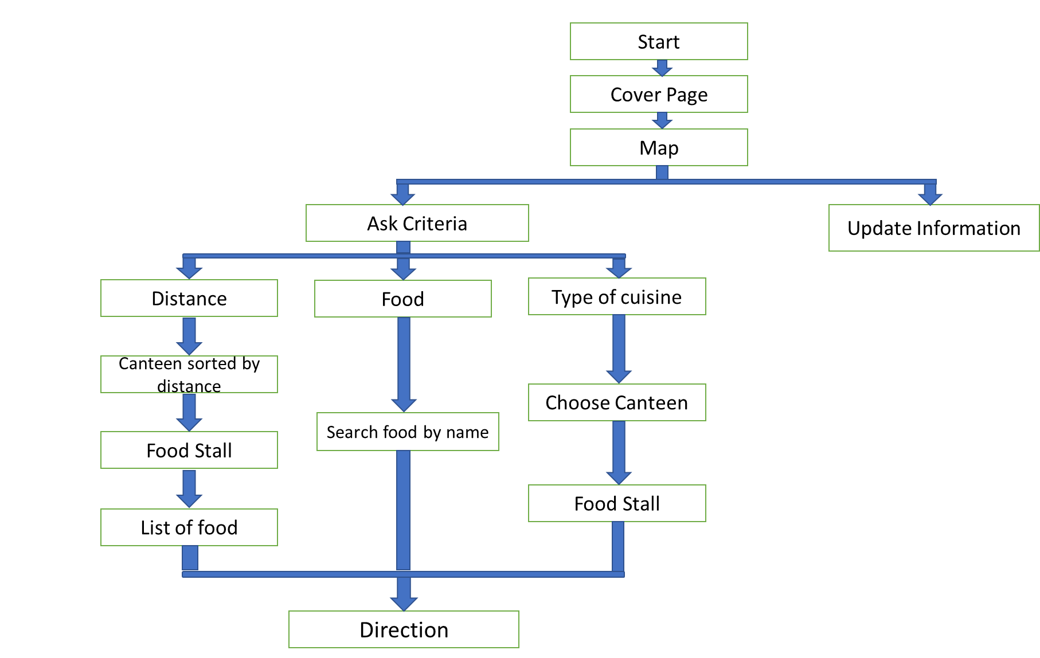

Slide 4
Typical Function Design
def function():
X = …
Y = …
}
Local Variables
Font, Image to display text on screen
While True:
Main function
Condition to execute next function
Condition to break the loop
Display texts, images to screen

Slide 5
Data Structure
Class ( Fixed Data)
Canteen (name, open time, location,..)
Stall (name, menu, type of cuisine,..)
List
Tuple

Slide 6
Techniques
Abstraction :
- List, Tuple, Class are used to store data
- Functions are used to divide program into different layers of execution
Decomposition:
- Use small functions to execute each parts of the program
Algorithm design
- Use merge sort, bubble sort to sort data by price, name.

Slide 7
Q&A

